Slide 1

SIG React Native 24-07-2018

Slide 2
React Native
Since 2015 publicly available
Framework for building mobile applications
Uses JavaScript and React
Native mobile app
Approach: “Learn once, write anywhere”
React Native
2
Notes:
-”Lean once, write anywhere” approach, instead of the “write once, run anywhere” approach. In other words, a developer should be able to build applications for whatever platform they desire, without needing to learn new technologies.

Slide 3
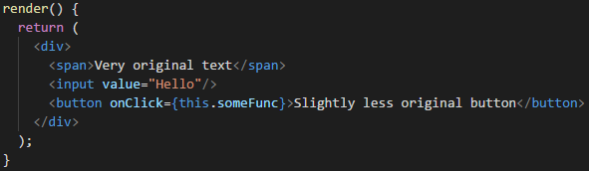
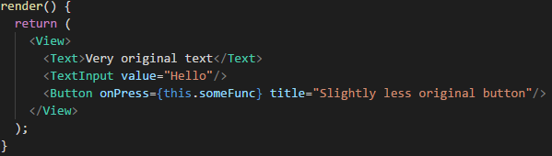
React Native
React render vs. React Native render
Uses React concepts like:
JSX, components, props and states
However:
No HTML or CSS
In-built react native components instead
React Native
3

Slide 4
Set-up
Easiest way to set-up:
Install “Create React Native App”
npm install –g create-react-native-app
create-react-native-app <appname>
cd <appname>
npm start
Install Expo app on your phone
Scan QR code to open project (Android)
Insert link in mobile webbrowser to open project (iOS)
React Native
4

Slide 5
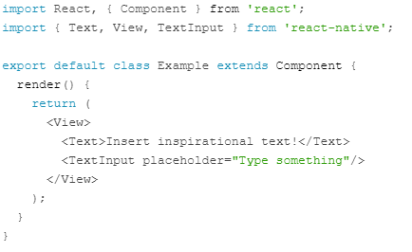

Basic Components
View
Container
Comparable with <div>
Text
Displays text
No headings like h1
Style it yourself
TextInput
Comparable to <input>
React Native
5

Slide 6
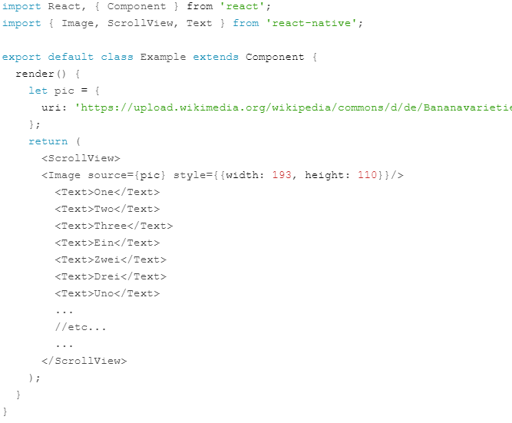
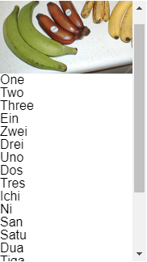
Basic Components
Image
Displays image
resizeMode
ScrollView
A Scollable View component
Normal View won’t let you
scroll when content overflows
React Native
6

Slide 7
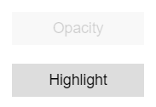
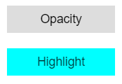
Button Components
TouchableOpacity pressed
Button
Basic button component
onPress event
Can only use text
Touchable
Create custom buttons
TouchableHighlight
TouchableNativeFeedback
TouchableOpacity
TouchableWithoutFeedback
TouchableHighlight pressed
React Native
7
Notes:
-Touchable can only have one child. You can however wrap multiple components into one view

Slide 8
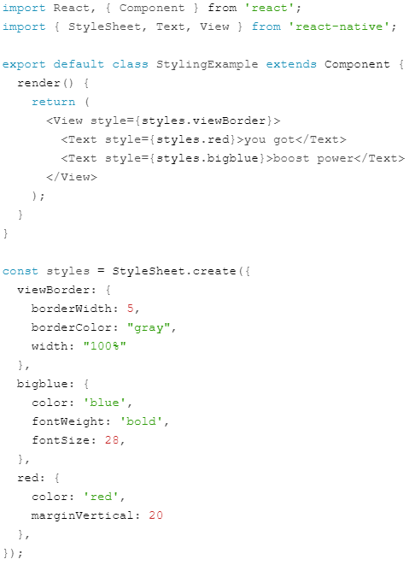

Styling
No CSS
Style prop: accepts JavaScrip object
Style names similar to CSS
StyleSheet component
Unitless
Percentages are also accepted
React Native
8

Slide 9
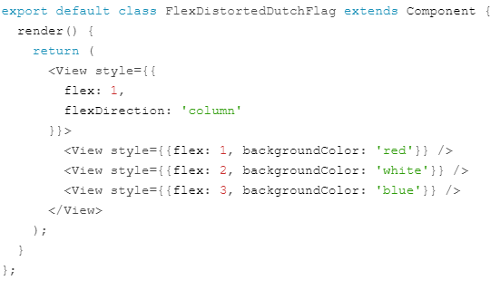


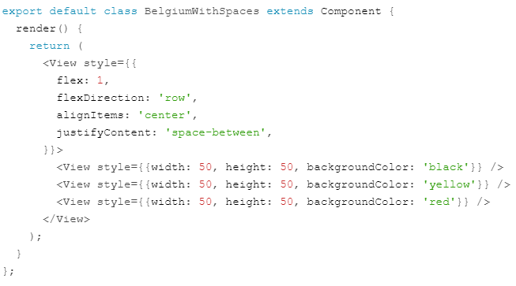
Flex
flex: (number)
flexDirection
alignItems
justifyContent
React Native
9

Slide 10

Hands-on Time!
Questions?
React Native
10

Slide 11
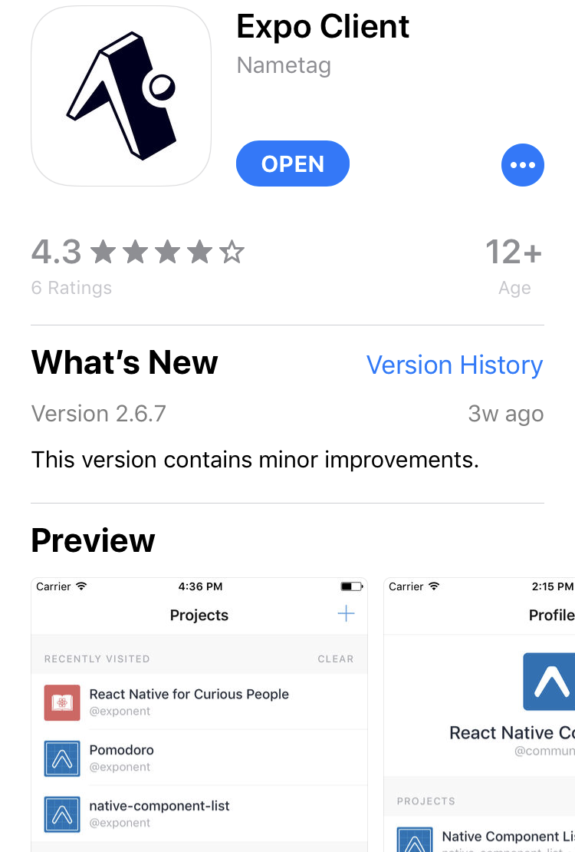
Hands-on: Setting up
Install Expo app on your phone
Cd into dir nativeExercise in directory react-series
yarn install and then yarn start
Android:
Open Expo app
Scan QR code from terminal to open project
iOS:
Insert link from terminal to webbrowser
Popup asking if you want to open in Expo
Press open
React Native
11

Slide 12
Hands-on: Copy previously created app
Copy the components and resources from the previously created app
CSS files are not needed
In App.js import the Accomodations component and put it in the render
Change background color in StyleSheet to lightgray
React Native
12

Slide 13
Hands-on: Appbar
Modify Appbar and use only React Native components instead of HTML elements
Remember: The View component can be used as a div and the Text component is used to display text
Add a StyleSheet and make it similar to the previously Appbar.css
Apply the styles
Modify Accomodations.js to let it only show the Appbar for now
React Native
13

Slide 14

Hands-on: Accomodation Card
Modify the AccomodationCard component
Native is not compatible with regular material-ui
Import { Card } from ‘react-native-material-ui’ instead
react-native-material-ui unfortunately does not contain Grid, remove it
For now, do not import the house icon just yet
Import the AccomodationCard component inside Accomodations
Add styling
Note: You cannot add the style prop to Card
Make sure you can see the cards with image, name, location and description
Use the following styling for image if it does not show up correctly:
React Native
14

Slide 15

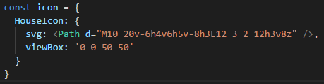
Hands-on: House Button
Open HouseIcon.js
Use the following imports:
Create an icon object:
Inside the SvgIcon element, remove the path
Add the props called name and svgs to SvgIcon element
name should be “HouseIcon” and svgs should be given the icon object
React Native
15

Slide 16

Hands-on: Add Button to Card
Import HouseIcon in AccomodationCard
Remember: Button can only use text, not icons
Remember: You don’t click on a button this time, you press it
Use a Touchable instead
Make sure color of icon differs depending whether favorite equals true
Hint: Use this iconColor object that passes on one of its properties to a fill prop
React Native
16

Slide 17
Handy references
React Native components and APIs:
https://facebook.github.io/react-native/docs/components-and-apis
Image-, Text- and View style props:
https://facebook.github.io/react-native/docs/image-style-props
https://facebook.github.io/react-native/docs/text-style-props
https://facebook.github.io/react-native/docs/view-style-props
Touchables:
https://facebook.github.io/react-native/docs/handling-touches
React Native
17

